Slide 1

Illinois Emission Rankings for the Data-Driven Decisions Tool
MoMo2025
& Illinois Department of Transportation
September 15, 2025

Slide 2
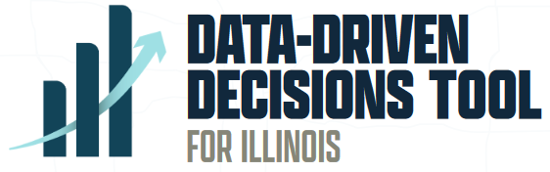





Data-Driven Decisions Tool
The DDD helps IDOT select projects based on 5 Goal Areas and 13 Selection Criteria.
Capacity expansion projects are analyzed in the DDD to ensure transparent and equitable decision-making.
Notes:
In 2021, Illinois HB253 was passed, which combined the performance-based approach emphasized by MAP-21 with increased scrutiny on capacity expansion projects. The goal of this bill was to increase transparency and equitable decision-making on projects with high levels of taxpayer investment and impact.
The data-driven decisions tool resulted from this law, built around 5 goal areas emphasized in both the bill and in IDOT’s LRTP. 11 selection criteria were used in the first evaluation rounds, with emissions and equity criteria added most recently.
The environmental impacts/livability section previously used useful but less specific metrics, namely the type of NEPA analysis required for the project, a simple environmental justice indicator, and if the project area has been impacted by an emergency event in the last 20 years.
It is important to note that while the DDD increases transparency, it compares all of our proposed capacity expansion projects against one another. So rather than looking at a congested, high job growth, or other notable corridor and using a tool to determine the best treatment, that piece happens before the projects get to this tool. We are ranking projects against one another.
Previously, 11 selection criteria were used, but this cycle included the addition of an emissions metric (discussed later) and an equity measure.

Slide 3
Underlying Concept
Activity (mi)
Emission Rate (g/mi)
Total Emissions
ILSTDM
MOVES

Slide 4
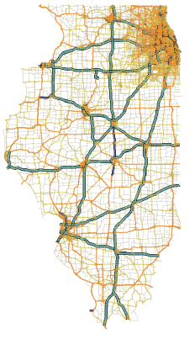


Modeling Tools
IL Statewide Travel Demand Model (ILSTDM)
EPA’s MOtor Vehicle Emissions Simulator (MOVES)
State-of-the-science model for mobile source emissions
First generation, trip-based statewide TDM
The ILSTDM contains an embedded emissions module, which combines rates from MOVES with ILSTDM vehicle activity data to estimate emissions

Slide 5
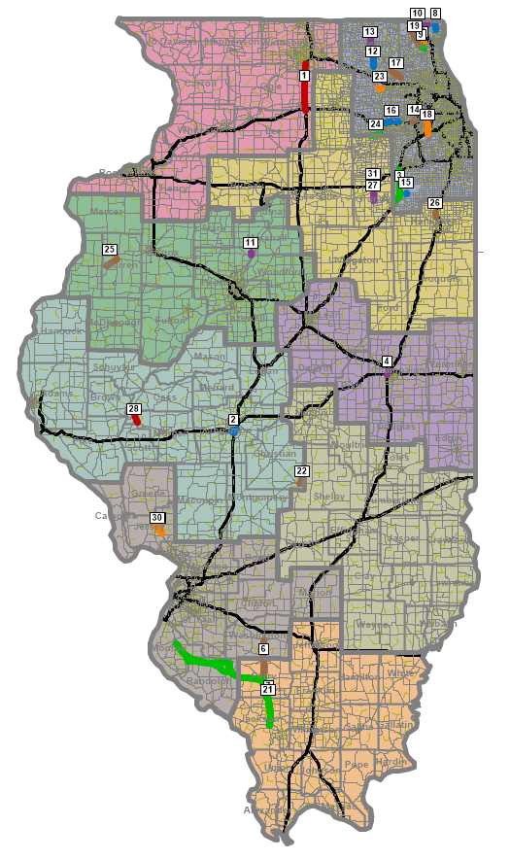
DDD Emissions Metric – Project Ranking
Calculate emissions for ‘base’ and ‘build’ scenarios, with the ‘build’ scenario evaluated for each group of projects
Emissions impact =
project emissions - base emissions
Normalized by calculating per-mile emissions
Ranked for each pollutant emissions
Projects that would compete with transit are penalized
Notes:
Dan
MYP list of projects
Projects can be grouped but testing has shown individual project testing is better. It avoids projects impacting each other.
Project methodology
Difference in emissions
Transit competitiveness: savings doubled; adverse impacts doubled.
Grams per day per mile
Projects ranked in order

Slide 6
DDD Emissions Metric – Project Ranking
10% of score
50% of score
Notes:
Dan
Transit Competitiveness
Emission Savings are halved
Emissions Increases are doubled
Project ranking:
Each pollutant ranked 1..x
CO2E ranked highest – accounts for all gasses
Scores are normalized 1 to 0.

Slide 7
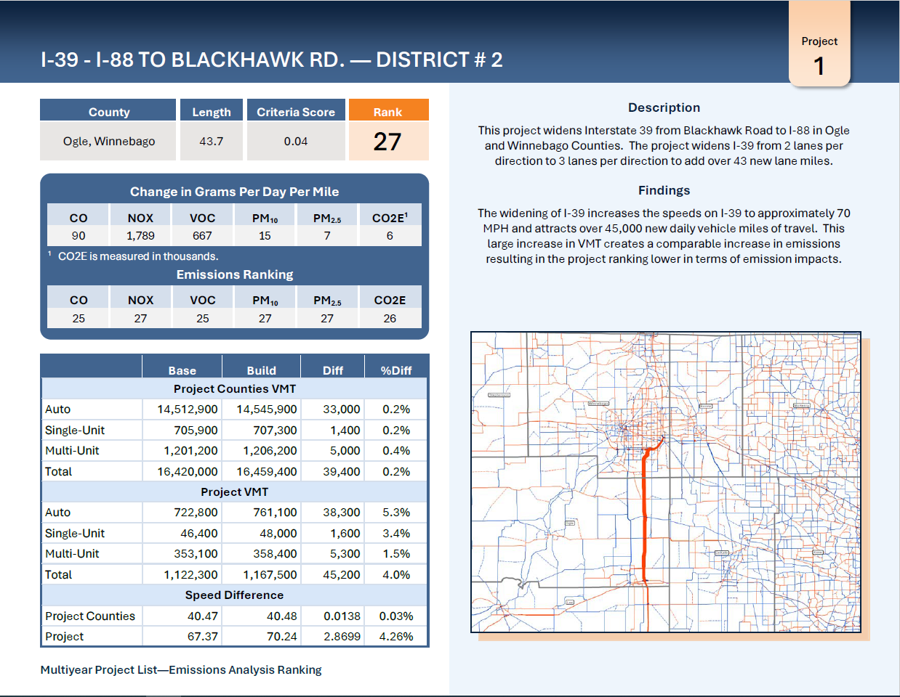
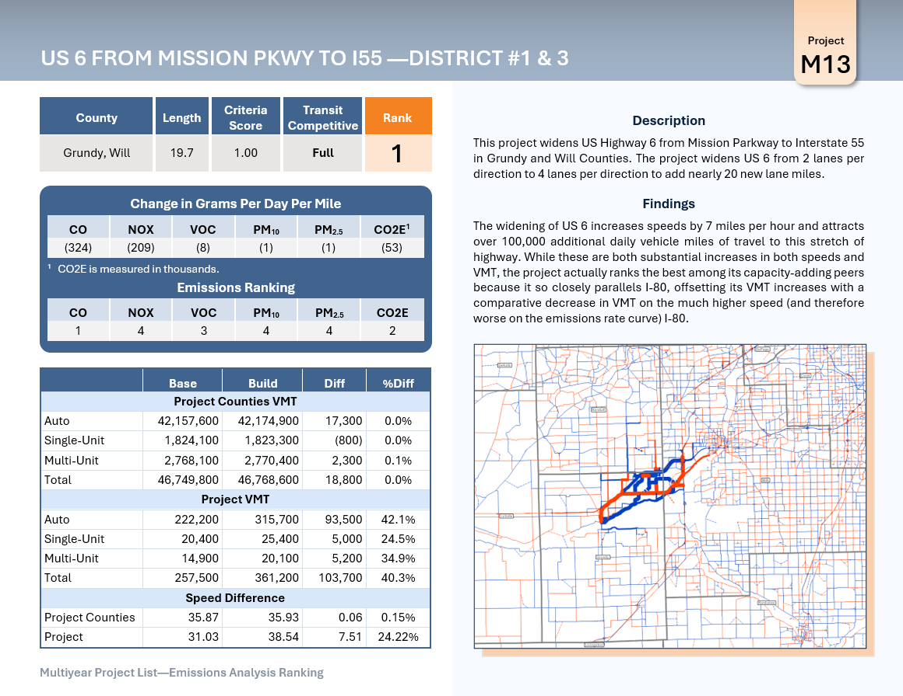
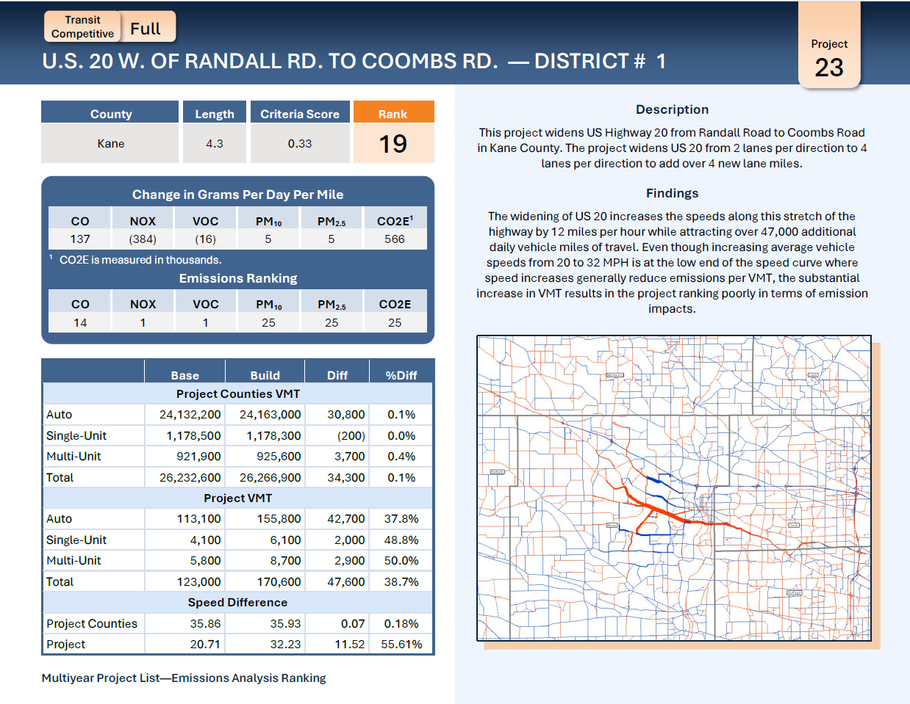
DDD Emissions Metric – Project Ranking
Project Summary
Emissions Ranking
Emissions Changes
Changes in VMT
County Level
Project Level
Volume Difference Map
Notes:
Dan
Transit Competitiveness
Emission Savings are halved
Emissions Increases are doubled
Project ranking:
Each pollutant ranked 1..x
CO2E ranked highest – accounts for all gasses
Scores are normalized 1 to 0.

Slide 8

Questions
Sophie Blumenstein
Sophie.Blumenstein@Illinois.gov
Sheng Chen
Sheng.Chen@Illinois.gov
Dan Tempesta
DTempesta@camsys.com

